Slide 1


Titolo presentazione sottotitolo
SAFESTREETS
Requirements Analysis and Specification Document & Design Document
Milano, XX mese 20XX

Slide 2

Firma convenzione Politecnico di Milano e Veneranda Fabbrica del Duomo di Milano
RASD
Goals of the system
Domain Assumptions
Requirements
Phenomena
Use Cases
Alloy Model
Aula Magna – Rettorato
Mercoledì 27 maggio 2015

Slide 3
Goal of the system
G3: Store relevant info about the violation in the data warehouse.
G4: Assist authorities in the process of law enforcement through automatic ticket compilation and elaboration of relevant statistics data.
G5: Guarantee security:
allow discarding of invalid reports;
avoid unauthentic officer registrations;
ban users who abuse of the violation reporting system.
Davide Cocco – Gasperini Marco 2019/2020

Slide 4
Domain Assumptions
D3: At least one of the city’s authorities’ server is always online to process reports.
D2-D4-D5: Users provide a valid email and they are in possession of device that support Mobile App and equipped with camera and gps.
D9-D14: Authorities correctly receive the great majority of reports and discard most of the invalid ones.
D11: Officers only sign correct tickets and always check the license plate matches with the reported one.
Davide Cocco – Gasperini Marco 2019/2020

Slide 5
Requirements
R12: Make the data warehousing and processing completely invisible to human actors to avoid manipulations.
R17-R18: update every actor’s map with the HFVZs every 30 seconds and only the authorities’ and officers’ maps with the new reports and repeat offenders' lists in real time.
R7-R9: Implement a supervised learning algorithm server-side which scans the multiple frames sent by the user to recognize the license plate, that must be accurate at least 99% of the times.
Davide Cocco – Gasperini Marco 2019/2020

Slide 6
Phenomena
PHENOMENON | SHARED | WHO CONTROLS IT?
Occurrency of traffic violation. | No | World
Filing a violation report. | Yes | World
Creation of traffic tickets. | No | Machine
Presentation of relevant data about violations and offenders. | Yes | Machine
Davide Cocco – Gasperini Marco 2019/2020

Slide 7
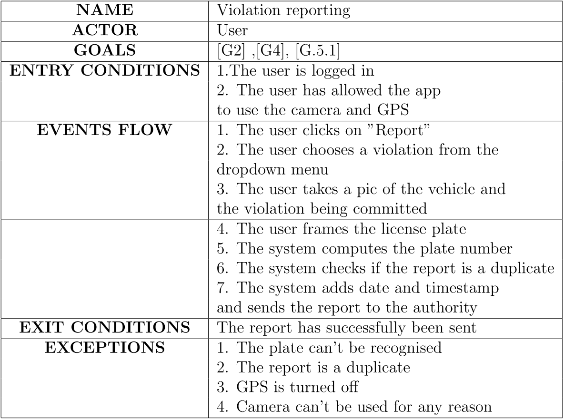
Use Cases
Davide Cocco – Gasperini Marco 2019/2020

Slide 8
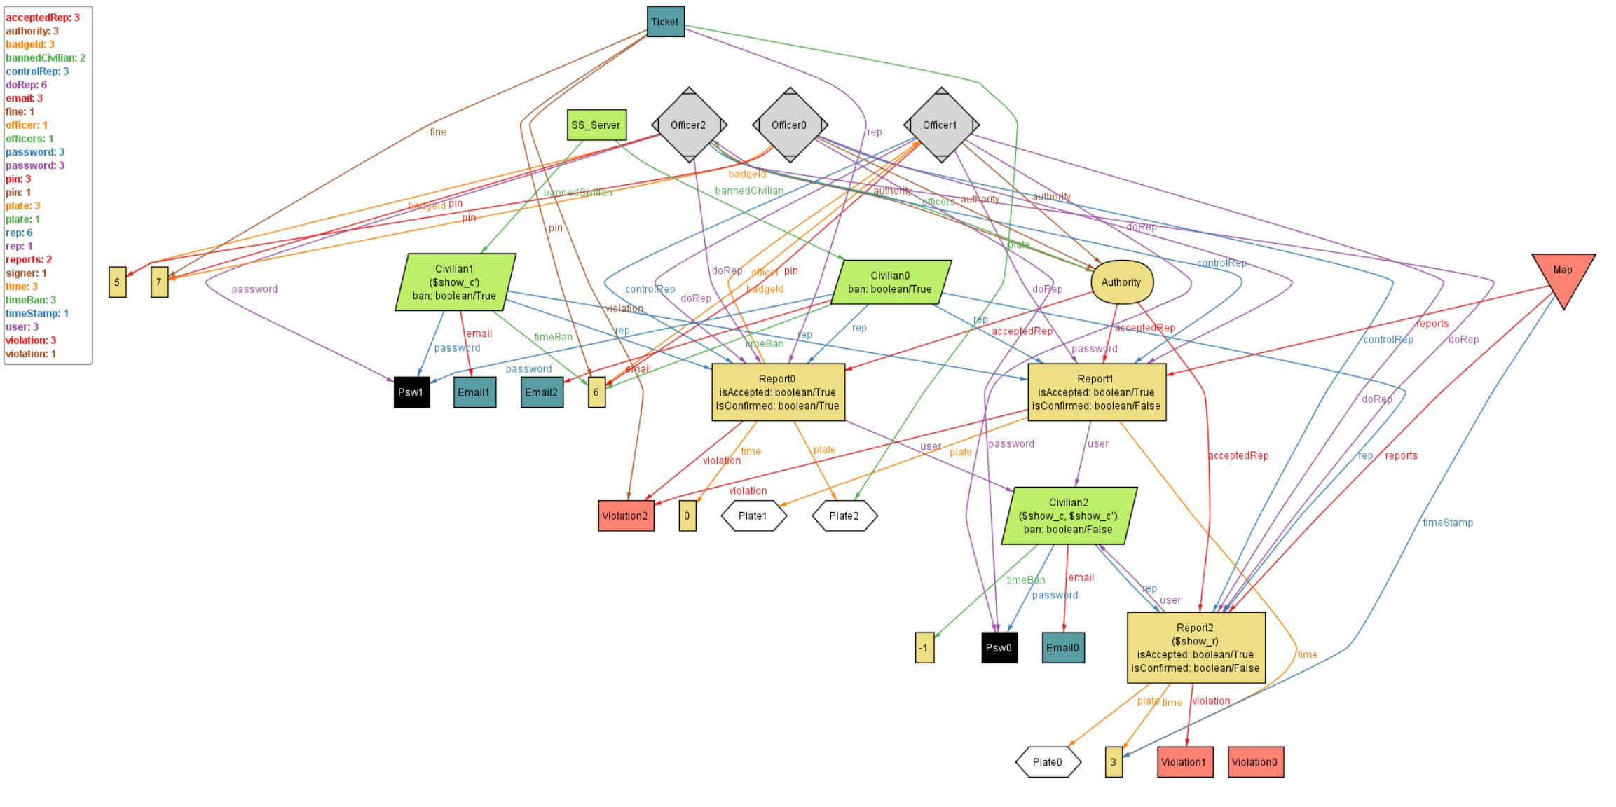
Davide Cocco – Gasperini Marco 2019/2020

Slide 9
Davide Cocco – Gasperini Marco 2019/2020

Slide 10
Davide Cocco – Gasperini Marco 2019/2020

Slide 11
Davide Cocco – Gasperini Marco 2019/2020

Slide 12
Davide Cocco – Gasperini Marco 2019/2020

Slide 13
Davide Cocco – Gasperini Marco 2019/2020

Slide 14
Davide Cocco – Gasperini Marco 2019/2020

Slide 15
Davide Cocco – Gasperini Marco 2019/2020

Slide 16
Davide Cocco – Gasperini Marco 2019/2020

Slide 17
Davide Cocco – Gasperini Marco 2019/2020

Slide 18
Davide Cocco – Gasperini Marco 2019/2020

